Slide 1
EECS 2500 Linear Data Structures
Lecture 07
Chapter 03 – The Stack ADT – Part 1
Fall 2016
Dr. Larry G. Thomas – University of Toledo/LCCC

Slide 2
Chapter Outline
3.1 Stacks
3.2 Collection Elements
3.3 Exceptional Situations
3.4 Formal Specification
3.5 Application: Well-Formed Expressions
3.6 Array-based Implementation
3.7 Link-based Implementation
3.8 Case Study: Postfix Expression Evaluator

Slide 3
Stacks
Section 3.1

Slide 4
Stacks (§3.1) - Overview
Stack:
An ordered groups of homogeneous elements
Items are always added and removed from the same end (called the “top” of the stack, regardless of whether the stack’s application really lends itself to the notion of “top” and “bottom”)
There is an ordering of elements on a stack
Elements on the bottom of the stack have been there the longest (conversely, the top of the stack has the “newest” elements), so the ordering is temporal
The item on top of the stack is the newest, and, because all operations happen at the top, it will be the first to be removed – Last-In, First-Out (LIFO)

Slide 5
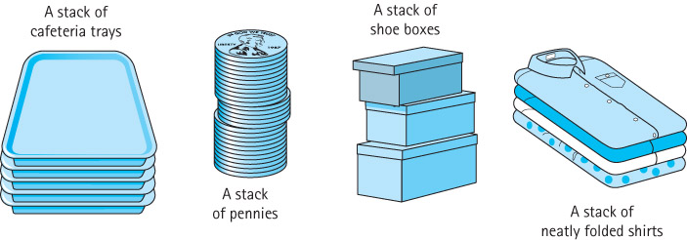
Stacks (§3.1) – Overview (2)
Stack:
Items go onto the stack ADT one at a time.
In the examples below, we could add more than one tray to the stack at once (or remove several at once)
Such a “compound” operation is really just a sequence of individual operations.
For the Stack ADT, we will always add/remove ONE item

Slide 6
Stacks (§3.1) – Overview (3)
Stack Operations:
A Stack’s constructor should initialize it to be empty (i.e., no items on the stack, ready to receive first item)
Once initialized, stacks have traditionally supported only two (mutator / transformer) operations:
Push – add an item to the (top of the) stack
Push a new plate onto the spring-loaded stack at the cafeteria
Pop – remove (discard) the (topmost) item on the stack
Modern programs have given rise to the need of a third (accessor / observer) operation:
Top – returns the item on the top of the stack, but leaves it there. Sometimes called Peek
The traditional stack combines Pop and Top: Pop returns the top item and removes it

Slide 7
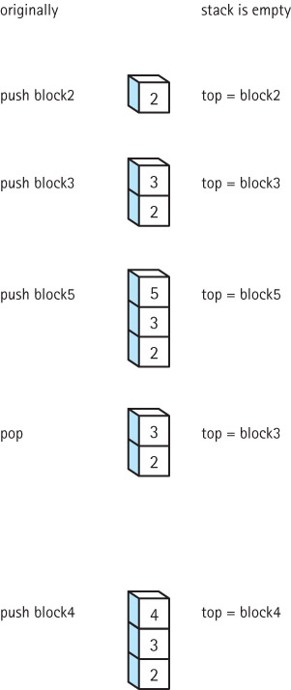
Stacks (§3.1) – Overview (4)
Effect of stack operations:
Start with empty stack
Push 2
Push 3
Push 5
Pop
Push 4

Slide 8
Stacks (§3.1) – Applications
Stacks are used extensively in computing
The “Call Stack”
When main calls method A, the system pushes onto the call stack the location in main to which it needs to return when A returns (the statement in main immediately after the call to A).
If A then calls B, the location in A to which execution returns (following B’s return) is pushed on top of main’s return location
Compilers use stacks to parse nested language elements (a for loop within a while loop within the else clause of an if/then/else statement, etc.
Parentheses are matched in arithmetic expressions using stacks.

Slide 9
Collection Elements
Section 3.2

Slide 10
Collection Elements (§3.2)
A collection is an object that holds other objects
Typically we are interested in inserting, removing, and iterating through the contents of a collection.
A stack is an example of a Collection ADT. It collects together elements for future use, while maintaining a first-in, last-out (or last-in, first-out [LIFO]; not FILO) ordering among the elements.

Slide 11
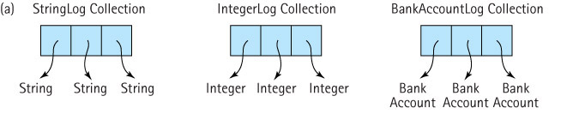
Collection Elements
Our StringLog was a collection ADT.
Unfortunately, it only collected (logged) Strings
What if we needed to log some other data type (like ints, or BankAccounts)?
We would need to code new log classes

Slide 12
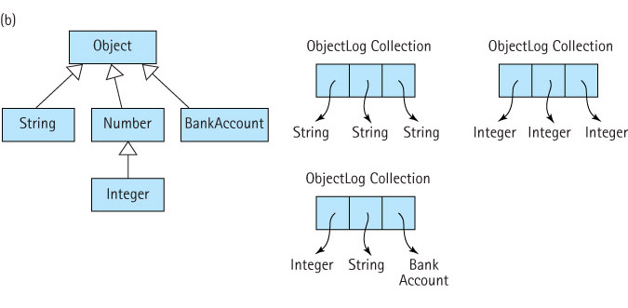
Collection Elements
Since all objects descend (inherit) from Object, we can create a generic ObjectLog, and put any data type in it (counting on polymorphism)

Slide 13
Collection Elements
Creating a generic ObjectLog does work, but whenever we remove an object from the log, it can only be referred to as an Object.
To use it any other way, we have to explicitly cast it back to the type of object it is
Collection.push("E. E. Cummings");
String poet = (String) collection.top();
System.out.println(poet.toLowerCase());

Slide 14
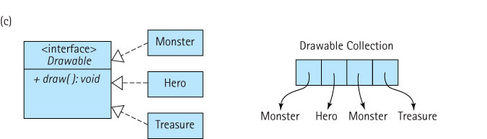
Collection Elements
Another approach is to make sure that our collection only supports objects that implement a particular interface (i.e., they’re all “legal” members of some group of classes)

Slide 15
Our Approach
For stacks, queues, unsorted lists, and graphs we use collections of class Object
For sorted lists (later in the semester) we use collections of a class that implements a particular interface, namely the Comparable interface
Another approach, generics, is discussed on pp. 166-167.
Generics basically allow us to leave the data type as a parameter.
We’ll be doing more with generics later
Generics were hotly contested when introduced to Java

Slide 16
A Word About Generics
People lived tolerably for many years, then suddenly it became essential that generics be shoehorned into the [java] language. This was remarkably coincidental with the appearance of generics in C#, which also appeared to produce several other features in Java 5. It seems that the urgency of these features came not from solving true problems in the Java language, but in Sun trying to maintain the perception of competitiveness against Microsoft's C#. This is probably not so far off the mark, because the reason that Java had to be rushed out in rough form in the first place was the belief that there was a market window that must be captured. A programming language designed by following marketing impulses is eventually going to end up chasing its tail.
- http://www.artima.com/weblogs/viewpost.jsp?thread=221903 (Jan 2008)

Slide 17
Exceptional Situations
Section 3.3

Slide 18
Exceptional Situations (§3.3)
Things can (and will) go wrong
A user enters an input value of the wrong type
While reading information from a file, the end of the file is (unexpectedly) reached
A user presses a control key combination
An illegal mathematical operation occurs, such as divide-by-zero
An impossible operation is requested of an ADT, such as an attempt to pop an empty stack
Exceptional situation: Associated with an unusual, sometimes unpredictable event, detectable by software or hardware, which requires special processing. The event may or may not be erroneous

Slide 19
Exceptional Situations
We saw exceptions last semester, when we wrote code to deal with exceptions that occurred in other code (try / catch / finally blocks)
Now that we’re designing ADT’s, we’ll be generating the exceptions (e.g., trying to pop an empty stack)
Now we need to look at exceptions from the bottom up, rather than the top down
Our experience with exceptions from 1510 will still be helpful, though.

Slide 20
Exceptions with Java
The Java exception mechanism has three major parts:
Defining the exception – usually as a subclass of Java's Exception class
Generating (raising) the exception – by recognizing the exceptional situation and then using Java's throw statement to "announce" that the exception has occurred
Handling the exception – using Java's try / catch statement to discover that an exception has been thrown and then take the appropriate action

Slide 21
Exceptions with Java
Some guidelines for using exceptions in java
An exception may be handled anywhere in the software hierarchy – from the place in the program module where it is first detected all the way to the top level of the program
Unhandled built-in exceptions result in program termination
Where in an application an exception is handled is a design decision; however exceptions should always be handled at a level that knows what the exception means
An exception need not be fatal (exception ≠ crash)
For nonfatal exceptions, the thread of execution can continue from various points in the program, but execution should continue from the lowest level that can recover from the exception.

Slide 22
ADT Exceptions - Example
public class Date // from Chapter 1
{
protected int year;
protected int month;
protected int day;
public static final int MINYEAR = 1583;
// Constructor
public Date(int newMonth, int newDay, int newYear)
{
month = newMonth;
day = newDay;
year = newYear;
}
// Accessors
public int getYear () {return year; }
public int getMonth() {return month;}
public int getDay() {return day; }
public int lilian()
{
// Purpose : Returns the Lilian Day Number of this date – Details omitted – See ch 1
}
public String toString()
{
return(month + "/" + day + "/" + year);
}
}
Let’s look at the constructor for a moment

Slide 23
Exceptions with Java
// Constructor
public Date(int newMonth, int newDay, int newYear)
{
month = newMonth;
day = newDay;
year = newYear;
}
Problems that can occur with the Date class can stem from trying to create it with an invalid date.
There’s no error checking to make sure it isn’t given the 13th month or the 32nd day – a “bad” date

Slide 24
Exceptions with Java
How should we deal with a “bad” date?
Crash immediately
Not very elegant; besides, we can do better
Write a warning message to an output stream
The ADT won’t know what output stream to use
Force the “bad” date to some “default” date (like 0/0/0)
If the program just keeps running, it will have bad data
It’s usually better to crash than to keep going with known bad data
Throw an exception!!
The caller tried to create the Date with bad data. Why not throw it back to them to fix?

Slide 25
Exceptions with Java
What exception to throw?
None of the java built-in exceptions seem to fit
There’s a DateFormatException, but this isn’t about the format; it’s about the values in the date itself
So, let’s create our own, and call it DateOutOfBoundsException
All exceptions inherit from Java’s Exception
Typically, roll-your-own Exceptions only have to create two constructors, mirroring (calling) the constructors in Exception
One takes a String argument; one has none

Slide 26
Making Our Own Exceptions In Java
public class DateOutOfBoundsException extends Exception
{
public DateOutOfBoundsException()
{
super();
}
public DateOutOfboundsException(String message)
{
super(message);
}
}
Just call the superclass’s (two) corresponding constructors!

Slide 27
New Date Constructor
public Date(int newMonth, int newDay, int newYear)
throws DateOutOfBoundsException
{
if ((newMonth <= 0) || (newMonth > 12))
throw new DateOutOfBoundsException("month " + newMonth + " out of range");
else
month = newMonth;
day = newDay;
if (newYear < MINYEAR)
throw new DateOutOfBoundsException("year " + newYear + " is too early");
else
year = newYear;
}

Slide 28
New Date Constructor
The rest of the logic (this isn’t a continuation of the previous slide; this code would have to be worked in):
// Categorically bad day of the month?
if ((newDay <= 0) || (newDay > 31))
throw new DateOutOfBoundsException("day " + newDay + "out of range");
// Day 31 of a 30-day month?
if (((newMonth == 4) || (newMonth == 6) ||
(newMonth == 9) || (newMonth == 11)) && (newDay == 31))
throw new DateOutOfBoundsException("day " + newDay +
" is not valid for month # " + newMonth;
// Continues next slide...

Slide 29
New Date Constructor
The rest of the logic (this isn’t a continuation of the previous slide; this code would have to be worked in):
// Check for Leap Year (LY)
// If the year is divisible by 4, it’s a LY (’04, 08,...)
// Unless it IS divisible by 100, and then it’s NOT a LY
// However, if it is divisible by 400, then it IS a LY
// LY’s: 1600, 2000, 2004, 2008, 1972, 1996, 2012, 2400
// NOT LY’s: 1700, 1800, 1900, 2100, 1995, 1997, 1998, 2013
//
boolean LY = (newYear % 400 == 0) ||
((newYear % 4 == 0) && (newYear %100 != 0));
if ((newMonth == 2) && // If February and too many days...
((LY && (newDay > 29)) || (!LY) && (newDay > 28)))
throw new DateOutOfBoundsException( "day " + newDay + "out of range");

Slide 30
Exceptions with Java
What happens next?
Given the new code in the constructor, our “black box” Date ADT can now throw a DateOutOfBounds exception.

Slide 31
Error Situations and ADTs
When dealing with error situations within our ADT methods, we have several options:
Detect and handle the error within the method itself. This is the best approach if the error can be handled internally and if it does not greatly complicate design.
Detect the error within the method, throw an exception related to the error and therefore force the calling method to deal with the exception. If it is not clear how to handle a particular error situation, this approach might be best - throw it out to a level where it can be handled.
Ignore the error situation. Recall the “programming by contract” discussion, related to preconditions, in Chapter 2 (p. 67 ff.). With this approach, if the preconditions of a method are not met, the method is not responsible for the consequences.

Slide 32
Throwing It Back Upstream
public class UseDates
{
public static void main(String[] args) throws DateOutOfBoundsException
{
Date theDate;
// Program prompts user for a date. M, D, and Y are set
// to the month, day ,and year (resp.) entered by the user
theDate = new Date(M, D, Y);
// Program continues ...
}
}

Slide 33
Handling it with try / catch:
public class UseDates
{
public static void main(String[] args)
{
Date theDate;
boolean DateOK = false;
while (!DateOK)
{
// Program prompts user for a date. M, D, and Y are set
// to the month, day ,and year (resp.) entered by the user
try
{
theDate = new Date(M, D, Y);
DateOK = true;
}
catch(DateOutOfBoundsException DateOBExcept)
{
System.out.println(DateOBExcept.getMessage());
}
} // end of while loop
// Program continues ...
}} // end of main and end of class

Slide 34
Exceptions with Java
One more note about exceptions
Exceptions descended from the class java.lang.RunTimeException (as opposed to the Exception class) do not have to be explicitly handled, because they can happen in virtually any method or segment of code
To anticipate them all would litter our code with try/catch
These are “unchecked exceptions”
See p.173 for more details

Slide 35
Stack – Formal Specification (§3.4)
Recall from Section 3.1 that a stack is a "last-in, first-out" structure, with three primary operations:
push - adds an element to the top of the stack
pop - removes (and discards) the top element off the stack
top - returns the top element of a stack
In addition, we need a constructor that creates an empty stack
Our Stack ADT will hold elements of class Object, allowing it to hold variables of any class.

Slide 36
Completing the Formal Specification
To complete the formal specification of the Stack ADT we also need to
Identify and address any exceptional situations
Determine boundedness
Define the Stack interface(s)

Slide 37
Exceptional Situations
pop and top – what if the stack is empty (no item at the top of the stack to remove / return)?
Throw a StackUnderflowException
Also define an isEmpty() method for use by the application
push – what if the stack is full (no room to push a new item)?
Throw a StackOverflowException
Also define an isFull() method for use by the application

Slide 38
StackOverflowException
public class StackOverflowException extends RuntimeException
{
public StackOverflowException()
{
super();
}
public StackOverflowException(String message)
{
super(message);
}
}
StackUnderflowException is exactly the same (Change all occurrences of "Over" to "Under", of course!)

Slide 39
Boundedness
We support two versions of the Stack ADT
a bounded version (has a limit as to how many items can be pushed onto the stack)
an unbounded version (no limit)
We define three interfaces
StackInterface: features of a stack not affected by boundedness
BoundedStackInterface: features specific to a bounded stack
UnboundedStackInterface: features specific to an unbounded stack

Slide 40
Inheritance of Interfaces
We’ve seen how one class can inherit from another. Interfaces can inherit from each other, too
Inheritance of interfaces: A Java interface can extend another Java interface, inheriting its requirements. If interface B extends interface A, then classes that implement interface B must also implement interface A. Usually, interface B adds abstract methods to those required by interface A.
The 3-prong outlet interface extends the 2-prong outlet interface (by adding the ground wire on the third prong)

Slide 41
StackInterface
public interface StackInterface<T>
{
void pop() throws StackUnderflowException;
// Throws StackUnderflowException if this stack is empty; otherwise,
// removes top element from this stack.
T top() throws StackUnderflowException;
// Throws StackUnderflowException if this stack is empty; otherwise,
// returns top element from this stack.
boolean isEmpty();
// Returns true if this stack is empty; false otherwise
}

Slide 42
The Other Two Abstract Methods
public interface BoundedStackInterface<T> extends StackInterface<T>
{
void push(T element) throws StackOverflowException;
// Throws StackOverflowException if this stack is full; otherwise,
// places element at the top of this stack.
boolean isFull();
// Returns true if this stack is full, otherwise returns false.
}
public interface UnboundedStackInterface<T> extends StackInterface<T>
{
void push(T element);
// Places element at the top of this stack.
}

Slide 43
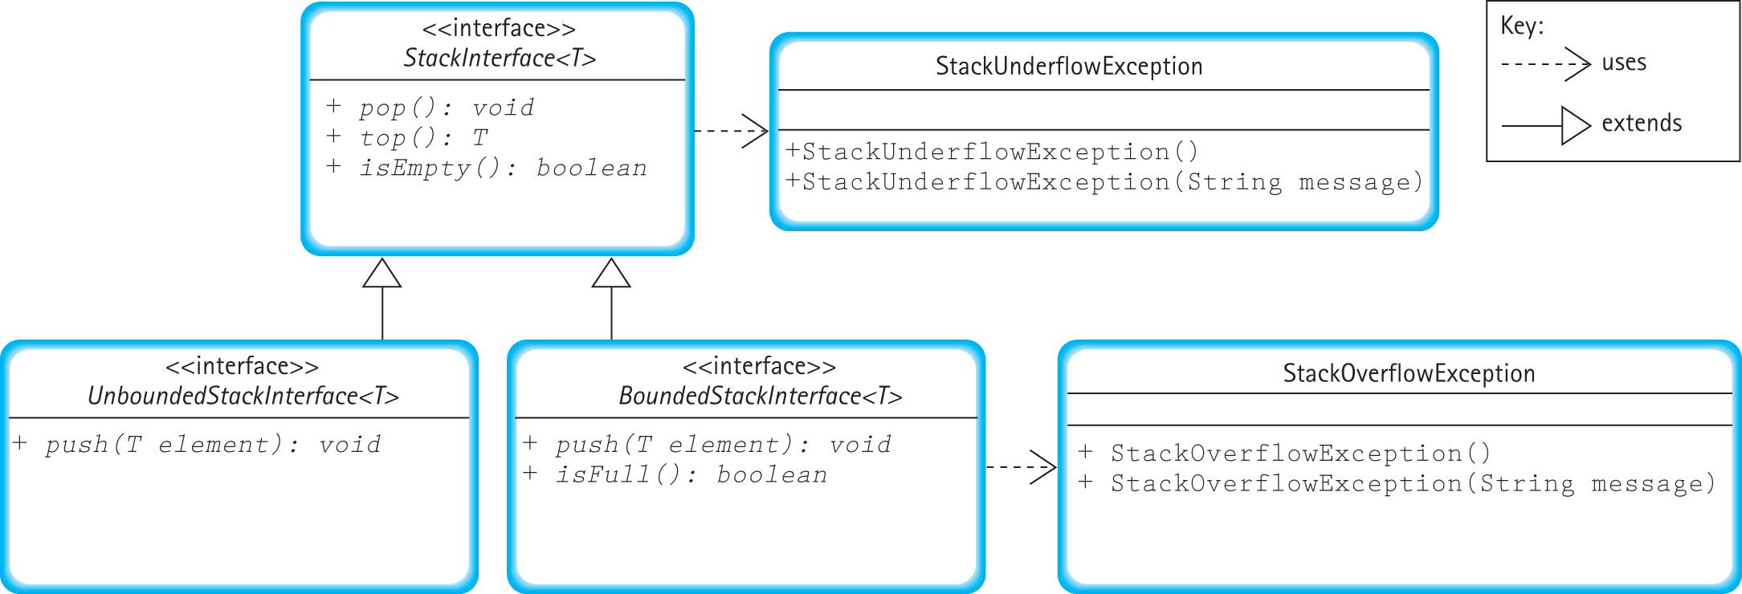
Interface/Exception Relationships

Slide 44
Example
The text gives an example (pp. 182-183)
This example takes whole strings and pushes them onto a stack, and then reads them back in reverse order
Another example (not in the book):
A String can be reversed by pushing its characters one-at-a-time onto a stack, and then popping them back off into a new string one-at-a-time
Or we can use the StringBuffer’s .reverse method!

Slide 45
Chapter 3 Will Continue…
? Questions ?

